Slide 1


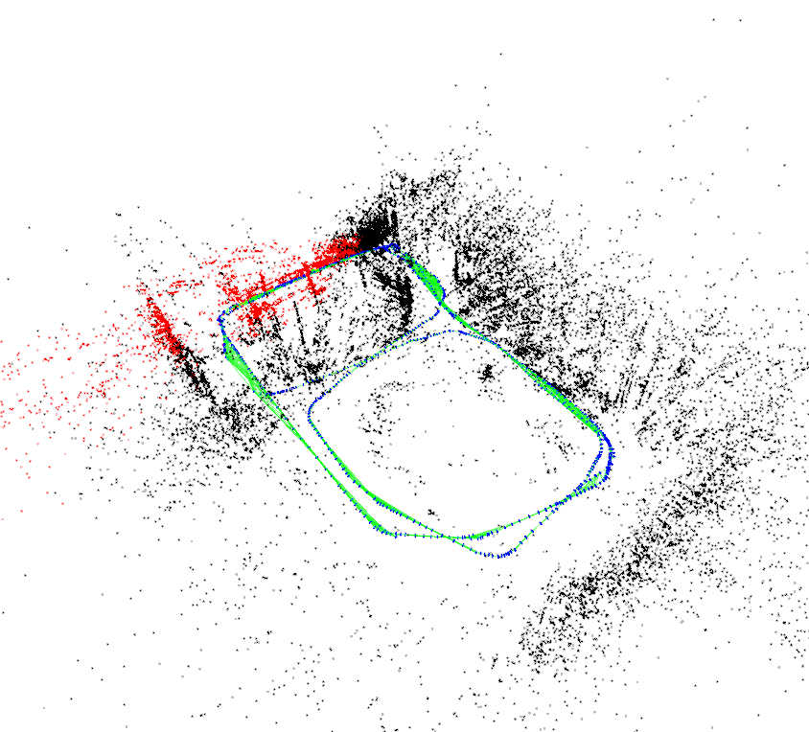
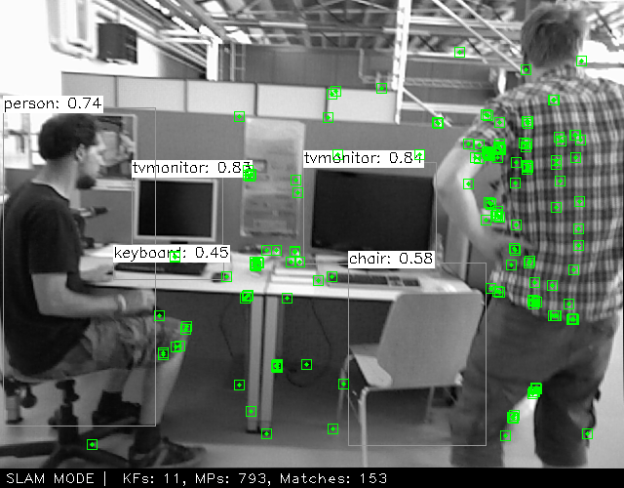
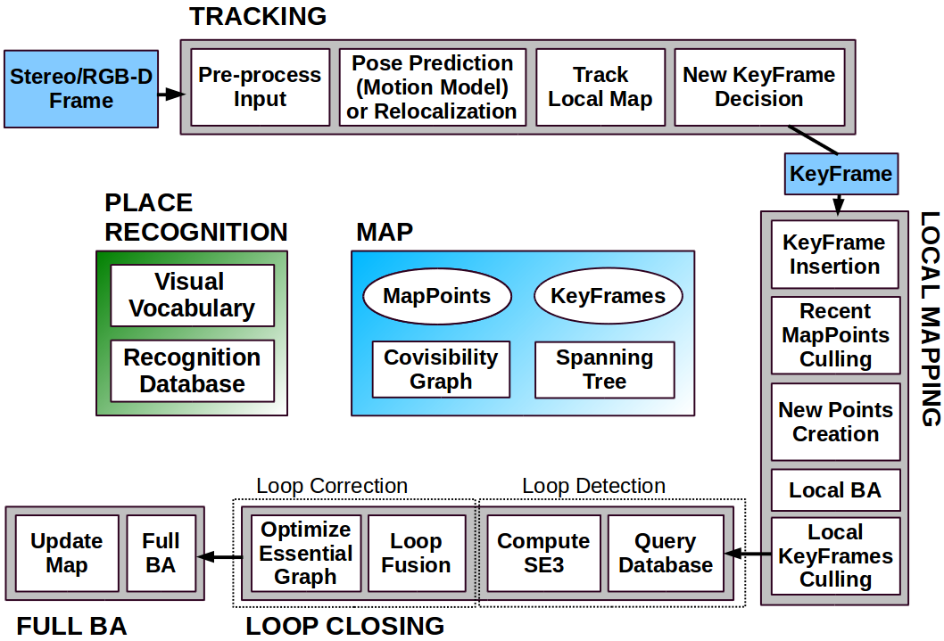
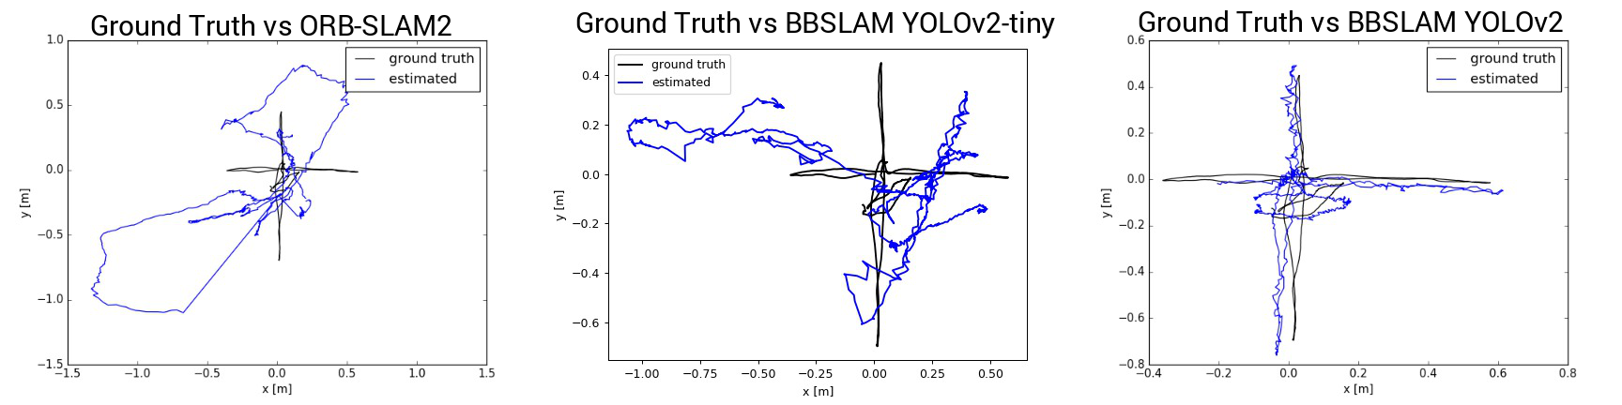
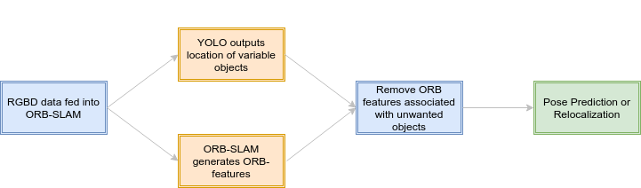
Bounding Box SLAM: A Fast, Selective SLAM
Abrar Anwar, Blake Holman, Michail Shaposhnikov Department of Computer Science, College of Natural Sciences, The University of Texas at Austin
Introduction
Figures and Results
Conclusion
Robots are generally unable to localize in crowded environments. To remedy this, attempts have been made to pair ORB-SLAM2 [2] with different selective methods to remove variable objects from the localization algorithm. These systems are successful in increasing accuracy in variable environments, but they are too slow to run in real time due to utilizing semantic segmentation and other computationally expensive methods. We solved this problem by using bounding boxes generated by YOLO, an object detection neural network architecture [3], to filter out the unwanted features and improve accuracy without sacrificing significant performance. This system shows significant performance increase to ORB-SLAM2 [2] on various benchmarks, and performs faster than all similar methods [1]. Thus, we propose Bounding Box SLAM (BBSLAM) as an effective solution to real-time localization in crowded, indoor environments.
Bounding Box SLAM (BBSLAM), which aims to remove features that were generated from variable objects in the environments to improve map building and localization accuracy. We find the area these objects occupy in the input image by using a trained version of YOLO, a neural network that outputs the bounding boxes of the objects that it is trained on[3]. The leftover features are thus more accurate because they are not based on unreliable objects. These features are used for either map-building or localization. Overall, while ORB-SLAM offers a notable improvement to the current robot localization accuracy and autonomy than current systems, a system that is selective about the features it uses may be significantly more robust.
Figure 1. Map built by ORB-SLAM2
Figure 2. Semantic information removed by YOLOv2
Various Statistics for ORB-SLAM2 vs BBSLAM
 | ORB-SLAM2 | YOLOv2-tiny | YOLOv2
RSME | 0.752 | 0.471 | 0.302
mean (m) | 0.629 | 0.433 | 0.275
median (m) | 0.457 | 0.384 | 0.264
std (m) | 0.411 | 0.187 | 0.125
min (m) | 0.610 | 0.150 | 0.050
max (m) | 1.679 | 0.998 | 0.763
Tracking Time for ORB-SLAM2 vs BBSLAM using YOLO
 | ORB-SLAM2 | YOLOv2-tiny | YOLOv2
mean (ms) | 30.06 | 106.30 | 254.42
median (ms) | 32.37 | 106.00 | 249.21
Acknowledgments
Research Goal
Most commonly used SLAMs fail in crowded or otherwise variable environments. Additionally, the few SLAMs that are good in crowded environments are too slow to use in real time. We aim to create a SLAM that both works in variable environments and is fast enough to work in real time by taking advantage of the YOLO architecture.
The authors would like to thank Dr. Justin Hart for his mentorship and guidance. The authors would also like to thank Harel Yedidsion for his help getting the project started.
The authors would also like to thank the FRI Student Peer Mentors for their help with debugging and improving the infrastructure of the BWI laboratory including but not limited to Jamin Goo, Mayuri Raja, and Stone Tejeda.
Looking at the plots, we can see the difference in quality of mapping between the different SLAM algorithms. In the first plot, we see the map that ORB-SLAM2 created. The black line is the known true path of the camera through the X-Y plane. The blue line is the trajectory that ORB-SLAM2 predicted the camera followed. As we can see, the blue line is connected, meaning the system did not delocalize very often. However, the blue trajectory is wildly off from the true trajectory at points where the robot encountered people in its frame of view. This shows that ORB-SLAM2 is not resilient to unreliable and transient objects while mapping. Next, we see the map that BBSLAM with YOLOv2-tiny created. The blue line is still a bit erratic but it resembles the ground truth path much more clearly now. The variation in the blue path can be attributed to transient moving objects that YOLOv2-tiny was not able to filter out because of the small size of the network. Lastly, we see the plot of BBSLAM with YOLOv2. This map mimics the trajectory of the ground truth nearly perfectly. YOLOv2's large and robust network allow BBSLAM to ignore people and other unreliable landmarks as it is creating the map. This leads to a much more accurate representation of the true path of the robot.
System Design
References
[1] Berta Bescós, José M. Fácil, Javier Civera, and José Neira. Dynslam: Tracking, mapping and inpainting in dynamic scenes.CoRR,abs/1806.05620, 2018.
[2] Rául Mur-Artal and Juan D. Tardós. ORB-SLAM2: an open-source SLAM system for monocular, stereo and RGB-D cameras.IEEE Transactions on Robotics, 33(5):1255–1262, 2017.
[3] Joseph Redmon, Santosh Kumar Divvala, Ross B. Girshick, and Ali Farhadi. You only look once: Unified, real-time object detection.CoRR, abs/1506.02640, 2015.
New Pre-Process Input Step

